Slide 1
Farm to Fork Strategy
Innovative technologies for climate change mitigation by Mediterranean agricultural sector– ClimaMED
LIFE17 CCM/GR/000087
https://life-climamed.eu/home

Slide 2
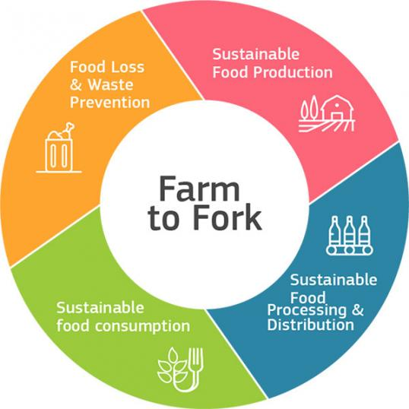
EU Farm to Fork Strategy
Ιs a key component of the European Green Deal.
Aim to reduce GHG emissions to achieve carbon neutrality by 2050 and ensure food production in the basis of social, environmental and economic stability.
Farm to Fork Strategy requires a transition of the entire food system towards
a fair,
healthy
and environmentally friendly
food system.

Slide 3
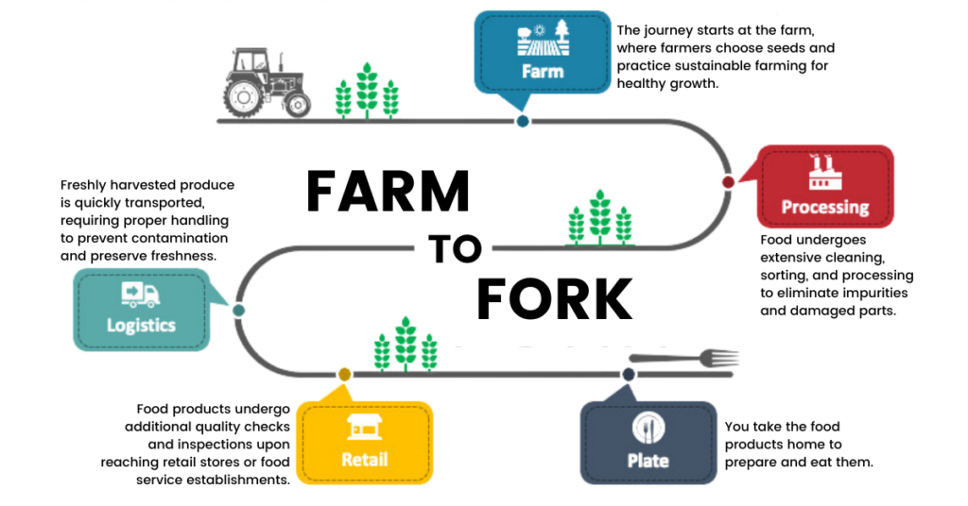

Slide 4
EU Farm to Fork Strategy
The aim of the strategy is to:
  Have a neutral or positive environmental impact,
  Mitigate climate change and adapt on its impacts,
  Reverse natural resources degradation and biodiversity losses,
  Access to sufficient, nutrition, safe and sustainable food,
  Promote fair trade and provide a fair income to famers,
  Preserve affordability of food and leave no one behind.

Slide 5




Farm to Fork: Goals
Climate Footprint | Global Transition | New Opportunities | Resilience
Reduce the environmental and climate footprint of the food system | Lead a global transition towards a competitive sustainability from fark to fork | Tap into new opportunities | Create robust and resilient food system

Slide 6
Farm to Fork: Resolving Issues
The Farm to Fork strategy promotes solution to address the EU challenges found in transitioning into a sustainable food system.
Social Sustainability | Economic Sustainability | Environmental Sustainability
Heathier diets – reduce overweight | Fairer income for farmers, fishers and aquaculture producers | Tackle climate change
Improve animal welfare | New business and job opportunities | Protect the environment
Social right for workers in food chain |  | Preserve biodiversity
Food affordability |  | Reduce food loss and waste
 |  | Circular bio-based economy

Slide 7
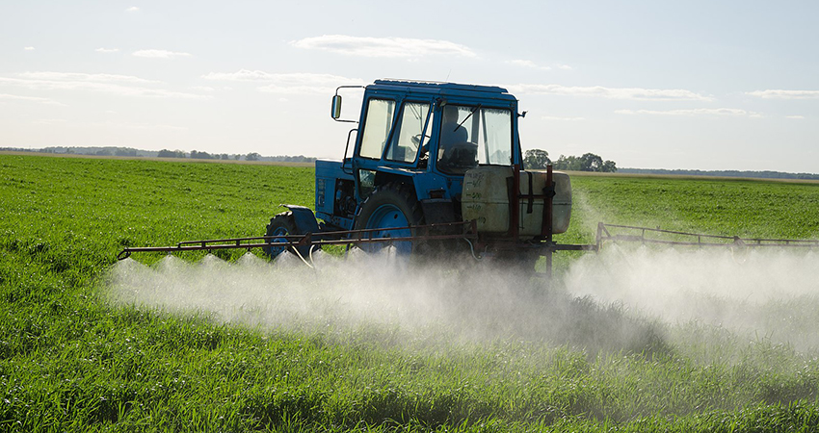
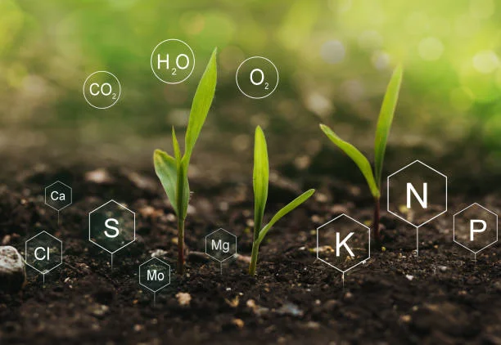
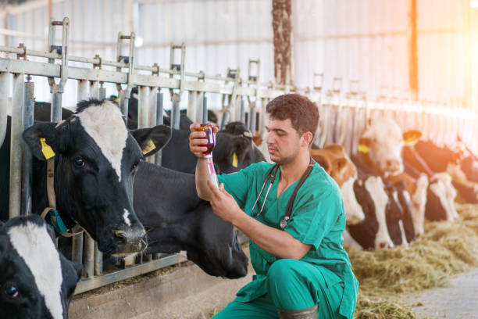
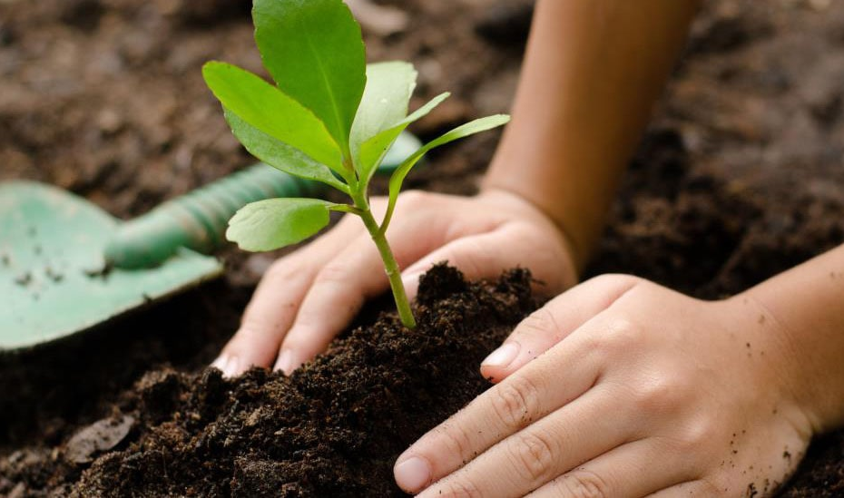
Targets by 2030
Reduce the overall use and risk of chemical pesticides and more hazardous pesticides by 50% | Reduce nutrient losses by at least 50% while ensuring no deterioration in soil fertility; this will reduce use of fertilizers by at least 20 % | Reduce sales of antimicrobials for farmed animals and in aquaculture by 50% | Achieve at least 25% of the EU’s agricultural land under organic farming and a significant increase in organic aquaculture

Slide 8
Different levels of implementation
EU - International
Advocate for sustainable global food systems
Producers
Adoption of sustainable practices by farmers, aquaculture producers, fishers and processors
Provide essential education
Citizens/ Consumers
Voluntary commitments
Changes towards healthy and sustainable diet
Research and Innovation
Funding mechanisms to support R&I
Strong corporation and alliance with partners around the world
Advisory services for sustainable farm management
Facilitate investments and partnership
Legislation and regulation

Slide 9
Benefits for farmers
  Help the transition to sustainable practices,
  Fair food supply chain and fair prices and resilience to fluctuations,
  Reduced post-harvest losses due to shorter supply chain,
  Improved traceability and quality control,
  Increased crop resilience,
  Provide diversified income streams (agrotourism, by-products, value-added products etc.) and lower production cost,
  Access to information and technology to support informed decisions and improve crop productivity,
  New global markets and business opportunities.

Slide 10
Sustainable Food Consumption
Diet changes
The current food consumption pattern are unsustainable from both health and environmental perspective.
The EU average person consumption of red meat, fats and sugars exceeds the recommended levels, leading to the rise of obesity levels and deaths caused by unhealthy diets.
Creating an environment that facilitate healthy and sustainable choices can assist the change to a more plant-based diet that includes sufficient portions of fruits, vegetables, legumes and nuts.
This can alleviate the health status of people as the risk of life-threatening diseases and especially cardiovascular is greatly reduced. Plant based diets carry also the benefit of reducing the environmental impact per capita.

Slide 11
Sustainable Food Consumption
Food waste
Reducing food waste translates to savings for consumers, protection of natural resources and preventing GHG emissions from landfills. The EU Commission is set to reduce food waste per capita by 50%. Measuring and monitoring food waste can help to explore ways of preventing them.
The quantification of food waste can help in setting measurable targets, tracking progress and evaluate the effectiveness of taken measures. The data provided by measuring food waste can gain insights on where and why food waste occurs to facilitate policy intervention or help waste organizations.

Slide 12
Transparent Information and Labeling
The Farm to Fork Strategy advocates for transparent and reliable information about food products, including their environmental footprint, to enable consumers to make informed choices. Food labeling changes may undergo various changes that are currently being examined:
Traceability: food labeling provides information about the origin of a product, methods used in production and relevant supply chain elements.
Nutrition labeling: Information about the health profile of food, like the salt, sugar and fat content of food products, to help consumers make healthier choices.

Slide 13
Transparent Information and Labeling
Sustainability labels: Consumers with sustainability concerns are able to make choices and support products based on their preferences. Eco-labels, organic certification or carbon footprint information are some examples.
Date marking: Revision on EU rules is also being examined to change date marking legislation in the effort to reduce food waste.
Storage and usage: information on storage and usage of a product can help consumers to better manage their products, reducing food waste.
Mandatory labeling of important information need to be addressed under EU regulations for a successful transition to sustainable choices in consumer level.

Slide 14
Farmers Contribution
Focus on soil health improvement through practices like composting, reduced tillage and crop rotation,
Embrace crop diversity through rotation and mixed cropping to enhance resilience and mitigate risks,
Optimize the use of water, fertilizers, and pesticides, through precision farming,
Implement traceability systems to track the journey of produce from the farm to the consumer,

Slide 15
Farmers Contribution
Use technology to provide consumers with information about the origin and production practices of their food,
Minimize post-harvest losses by optimizing storage and transportation practices,
Explore value-added products or secondary markets for surplus produce

